Slide 1

UAC
CEO/Lead Instructor: Brandon Dennis, OSCP

Slide 2
What is UAC?
User Account Control
Provide temporary administrative rights to a process during a single run
Helps mitigate the impact of Viruses and Malware

Slide 3
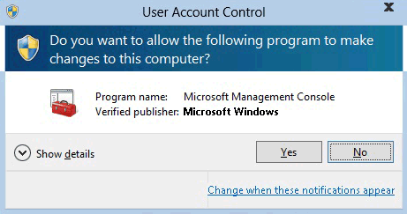
What Does UAC Look Like?
It is usually a prompt after you attempt to run something that requires administrative privileges when logged in as a standard user
This can also prompt for the local administrators password as well

Slide 4
How does UAC Work?
User Opened Application
Run Executable With Higher Rights
Yes
ShellExecute
Create Process
Secure Desktop Enabled?
Yes
High
Application Info Service
Active X Installed?
No
No
UAC Slider Level
Medium
Yes
Application Signed?
Low

Slide 5
Is an Admin the same as a User?
When a standard User logs in they are provided a Standard Access Token to be used for their session
Administrators are provided a similar Standard Access Token but are also assigned a Full Administrator Access Token

